Slide 1
Semantic Web
Jo Munson
j.munson@soton.ac.uk

Slide 2
Semantic Web – Learning Outcomes
1 Emergence of the Semantic Web
Task 1
2 Pros and cons of the Semantic Web
3 Ontology design
Task 2a
Task 2b (“Homework”)

Slide 3

The (World Wide) Web = Web 1.0
- Developed in CERN by Tim Berners-Lee and Robert Cailliau
- Allowed information to be shared across the world by using unique identifiers and corresponding unidirectional links between documents
- Has retrospectively been labelled “Web 1.0” due to two major developments...
1 Emergence of the Semantic Web
http://theweb.com/mydoc

Slide 4


The Social Web = Web 2.0
- Democratisation of authorship (barriers to authorship reduced by social networking sites)
- Emphasis on connecting people rather than documents
- Emphasis on sharing a broad range of media
1 Emergence of the Semantic Web
http://thesocialweb/coolvid
http://thesocialweb/myfriend

Slide 5

The (Social) Semantic Web = Web 3.0
- Items of data within documents can be linked to
Data have ‘meanings’ and these meanings can be re-used
Data can be queried
1 Emergence of the Semantic Web
http://theweb.com/mydoc#mypenguin

Slide 6
Semantic Web vision
“To a computer, the Web is a flat boring world, devoid of meaning. This is a pity, as in fact documents on the Web describe real objects and imaginary concepts, and give particular relationships between them.”
(Berners-Lee 1994)
1 Emergence of the Semantic Web

Slide 7
Semantic Web vision
Adding semantics requires two things:
Machine readable formats
Relationships between links
1 Emergence of the Semantic Web

Slide 8
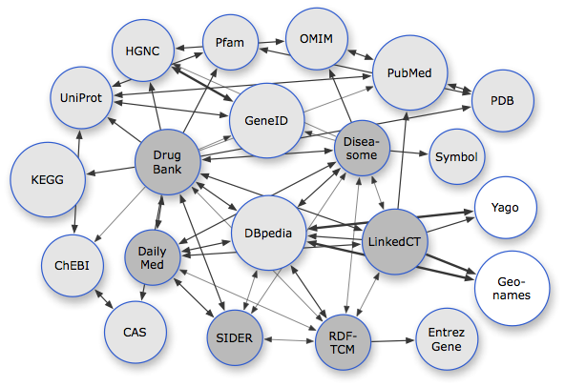
Web of Data
No longer linking documents, but data:
1 Emergence of the Semantic Web
http://enakting.org

Slide 9



Web of Data
Infer equivalence:
1 Emergence of the Semantic Web
@Bloggy_Joe
Joe Bloggs
Joseph Bloggs

Slide 10
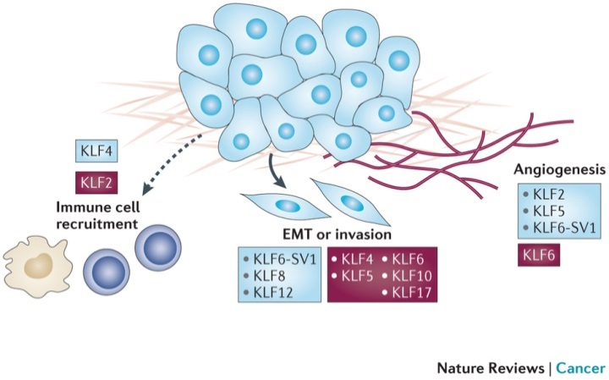
Web of Data
Re-use data:
1 Emergence of the Semantic Web
Cancer Data
Researcher 1
Researcher 2
http://nature.com

Slide 11
Task 1 Evolution of the Web
1 Emergence of the Semantic Web
http://tiny.cc/4gocgy/semweb

Slide 12
Affordances (Pros) of the Semantic Web
Machine readability (improved search/discoverability)
Interoperability (linking diverse resources)
Way to link data, not just pages
Cut down on redundancy (redefining same terms many times)
2 Pros and cons of the Semantic Web

Slide 13
Limitations (Cons) of the Semantic Web
Standards too complex to implement across existing Web
Interfaces too complex for average user to be motivated to use going forwards
Are the proposed technologies robust to deal with next developments in Web?
2 Pros and cons of the Semantic Web

Slide 14
Affordances of the Social Semantic Web
Offers opportunity to make sense of the mass of bottom-up data created via the ‘Social Web’
Can be partially achieved through Folksonomies – lightweight ontologies that use e.g. hashtags to markup Web
Wikis can act as collaborative conceptualisation of ideas and be linked/annotated using RDF
2 Pros and cons of the Semantic Web

Slide 15
Limitations of the Social Semantic Web
Folksonomies are not hierarchical/unique so inference is harder/less powerful
Wikis still conform to a document structure/are not easily reusable across Web
2 Pros and cons of the Semantic Web

Slide 16
Shared vocabulary = ontology
To share data effectively, we need:
Shared terminology
Shared perspective
These allow us to:
Communicate with a mutual comprehension
Re-use data (reduce instances of same person/object)
Interoperability
3 Ontology design

Slide 17
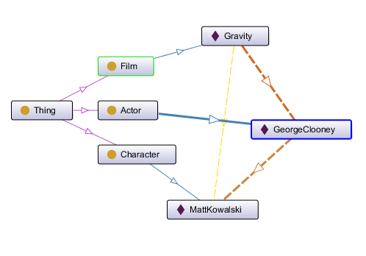
What is an Ontology?
An agreed conceptualisation
A set of reusable vocabulary
A set of reusable relations
Logical hierarchy that allows extensibility
3 Ontology design

Slide 18
What is an Ontology?
Ontology - "Explicit formal specification of shared conceptualisation"
Building an Ontology:
Why are you building it?
What is it for?
Define competency questions (queries the ontology should support). The Ontology needs to fulfil the competency questions, no more, no less.
3 Ontology design

Slide 19
Conceptualisation
Rough draft names of classes, relations, roughly map out how will relate to each other
Check for existing Ontologies, and reuse/import them where appropriate
3 Ontology design
Class
Animal
Cat
Max
Instance
Tabby
Dog
Felix

Slide 20
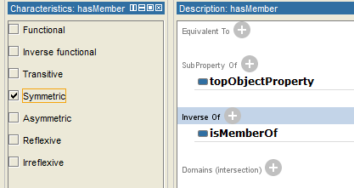
Ontology design - Formalisation
Define the hierarchy, decide which classes should be disjoint
Define relations:
Functional
Transitive
Symmetric
Asymetric
Reflexive
3 Ontology design
Cat
disjoint with
Dog
→ can’t be both a cat and a Dog

Slide 21
Formalisation
Ways to create hierarchy:
1. Top-down - work from super-classes and specialise as go down
2. Bottom-up - define the most specific classes and then work back up to general classes
3. Top-down, bottom-up - start from the most obvious classes and work up and down from there
3 Ontology design

Slide 22
Formalisation
Use a naming convention, e.g. Java naming convention
http://en.wikipedia.org/wiki/Naming_convention_(programming)#Java
Use singular nouns for class names, e.g. ‘Film’ not ‘Films’
'Subclass of' is not the same as 'part of' e.g., Wheel should not be subclass of Car, because a wheel is not a type of car
3 Ontology design

Slide 23
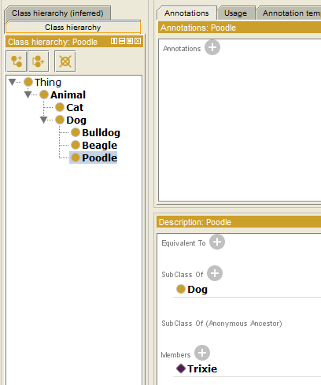
Formalisation
Class or relation? If your classes are likely to have further subclasses, better to do subclasses
Class or instance? If you expect to have (sub) instances or subclasses, should be a class, otherwise, should be an instance!
3 Ontology design

Slide 24
Implementation & Evaluation
Implementation - use editor, e.g. Protégé (Easier to visualize and document than coding by hand)
Evaluation - does it do what I need it to do? Check against competency questions devised at beginning.
3 Ontology design

Slide 25
Documentation
Guide to allow other people to use your ontology
Structured documentation:
- Concept - Long definition of what class means and how it is distinct from other classes
Terms - What other terms are equivalent / near synonyms (to help with use) e.g. Animal, Creature, Species
- Description - Dictionary style short definition
- Examples - Examples of use, e.g. Jeff Vass is a Lecturer
3 Ontology design

Slide 26
Summary
- Building an Ontology is an iterative process
- There is no single correct model for your domain
- Re-use existing Ontologies where appropriate (don't reinvent the wheel)
- If met competency questions, done enough
- Avoid redundancy (don't model same thing in two different ways)
- Give specific names for things (e.g. don't define an Object Property with a general term like ‘has’)
3 Ontology design

Slide 27
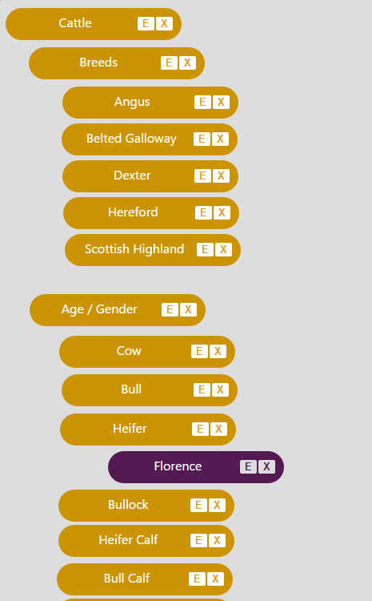
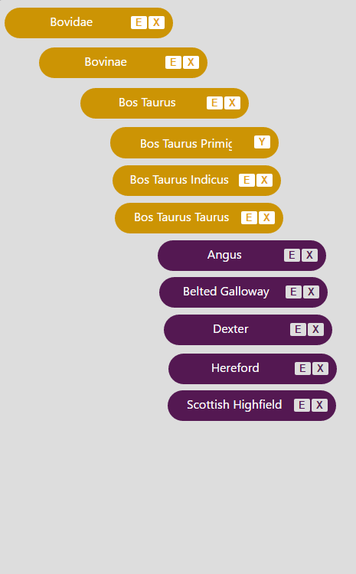
“There are more ways than one to skin a cat”…
3 Ontology design

Slide 28
Task 2 Ontology planning
3 Ontology design
[Link will be here by the time of lecture]

Slide 29
Task 3 (“Homework”) Coding up your ontology
3 Ontology design
[Link will be here by the time of lecture]

